Slide 1
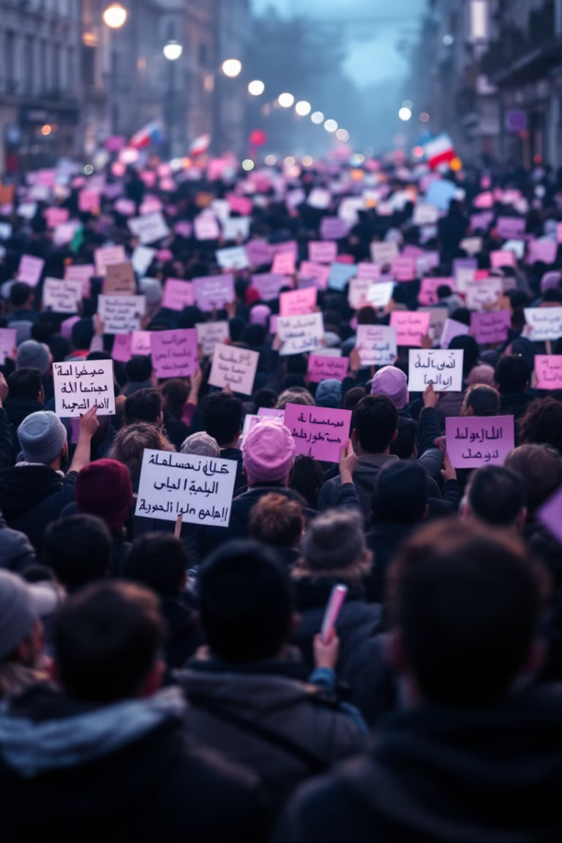
Leveraging LLMs for Conflict Data Analysis and Insights

Slide 2

Introduction
Datasets like ACLED offer vital text-based information on global conflicts, protests, and civil unrest.
Analyzing this data is essential for organizations like the World Bank to understand conflict causes, track protest trends, and inform policy.
Unstructured nature makes direct extraction of insights challenging.
Large Language Models (LLMs) and Natural Language Processing (NLP) can streamline the processing and analysis of this unstructured data.This project aims to improve the interpretability of conflict-related text data, focusing on Iran protest events, to provide actionable insights for conflict resolution and policy making.

Slide 3
Background and Context
Global Unrest and the Need for Analysis
ACLED Dataset
NLP & LLMs for Conflict Insights
ACLED: A real-time dataset tracking global political violence and protest events.
Civil unrest and protests reflect deep socio-political grievances, especially in politically unstable regions like Iran.
NLP: Analyzes unstructured text to identify themes and motivations behind protests.
Challenge: Unstructured data (text) requires NLP and LLMs to extract insights effectively.
LLMs: Extract topics and relationships, offering actionable insights for policymakers.
Understanding protest causes is vital for managing conflicts and shaping policy.

Slide 4
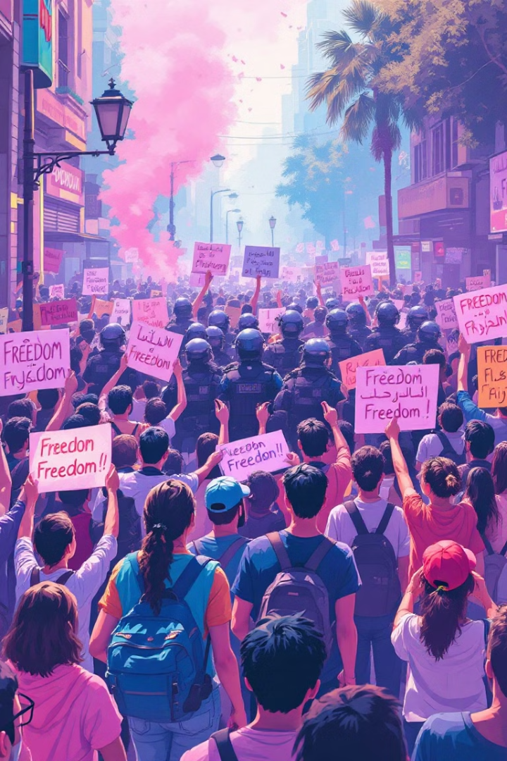


Problem Statement
Analyzing Unstructured Data
The challenge lies in analyzing unstructured protest data from the ACLED dataset, specifically focusing on protests in Iran, to determine the root causes of unrest.
Applying Topic Modeling
Topic modeling and clustering techniques are used to uncover key themes and motivations behind protests, helping to structure and interpret complex data.

Slide 5



Elaboration of Objectives
My project aims to leverage ACLED data and NLP techniques to extract actionable insights and generate supporting materials for understanding protests, specifically focusing on Iran's protest events from 2016 to the present.
Extract Actionable Insights
Leverage ACLED Data
Generate Supporting Materials
Identify the reasons behind public participation in protests.
Focus on Iran's protests from 2016 to the present for relevant information.
Produce visualizations and documentation to support global research efforts.

Slide 6
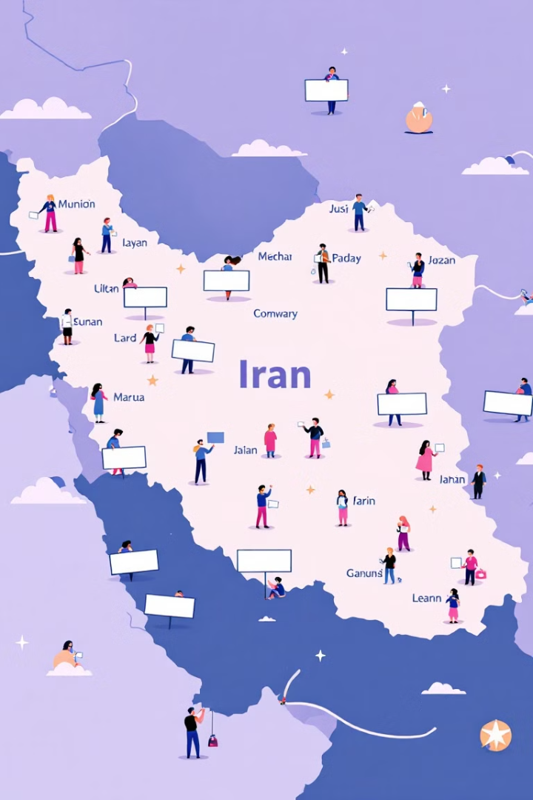



Project Scope
Focus Area
Protests in Iran, spanning from 2016 to 2025.
Methods
LDA, Top2Vec, Bertopic, LLaMA 2 and Mistral
Limitations
Focus on Iran protests; insights may not be generalizable to all conflict zones.

Slide 7
Literature Review
1
1. Topic Modeling of Ongoing Conflict Between Russia and Ukraine Pradhan Nayak et al. (2022) This paper applies Latent Dirichlet Allocation (LDA) to analyze media reports related to the ongoing Russia-Ukraine conflict.
Key Methods: It uses text preprocessing techniques such as stop word removal and lemmatization. The gensim library is utilized for LDA topic modeling, with hyperparameter optimization (e.g., the number of topics and alpha) to improve model accuracy.
Visualization: The study uses tools like word clouds and pyLDAvis to enhance the interpretability of topics and make the results more accessible to users.
2
2. LimTopic: LLM-based Topic Modeling and Text Summarization for analysing Scientific Articles limitations Al Azher et al., 2024
This paper applies a hybrid pipeline using BERTopic combined with LLMs (GPT-4, LLaMA, Mistral) to generate interpretable topic titles and concise summaries from limitation sections of scientific articles. Their approach outperformed traditional LDA and standalone BERTopic by improving coherence and silhouette scores.
Relevance to My Project: My protest analysis pipeline aligns with this framework—using BERTopic with contextual embeddings and applying LLMs (e.g., Mistral-7B) for enhanced topic interpretation. Like LimTopic, we generate human-readable topic titles and summaries, which support analysts in understanding underlying grievances within Iran’s protest narratives.

Slide 8
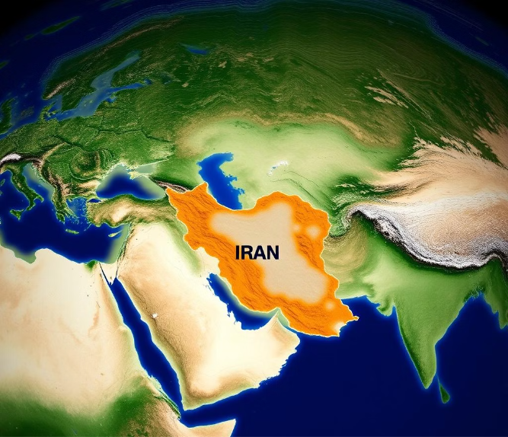
The ACLED Dataset
This card visualizes key aspects of the ACLED dataset, focusing on its structure and temporal scope.
Key details of the ACLED dataset:
1
Source : ACLED Website (Freely Available)
2
Shape : 26,178 (rows) , 31 (columns)
3
Key Feature : notes
4
Timeline : January 1, 2016 - February 13, 2025
ACLED - Armed Conflict Location and Event Data

Slide 9



Methodology
2
Data Preprocessing
1
Data Collection
Data Modeling
3

Slide 10
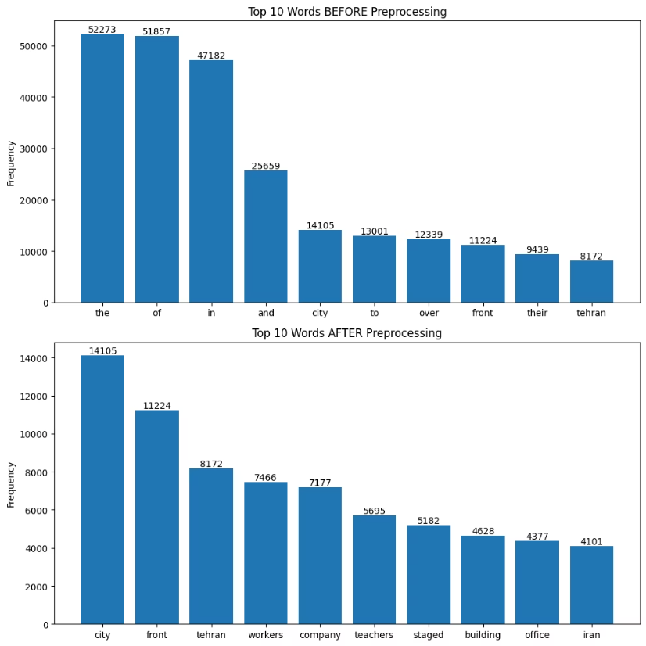
Data Pre-Processing
Converted text to lowercase
Remove non alpha-numeric characters
Tokenized the text
Removed stopwords using the nltk stopwords list
Defined a custom stopwords list
Removed words with fewer than three characters
Removed dates and protest-related action verbs

Slide 11
Data Modeling - LDA
WHY LDA?
HYPERPARAMETER TUNING
LDA captures overlapping themes better, useful for protests that relate to multiple issues.
I optimized num_topics, alpha, and eta to improve CV Coherence Score and Topic Diversity scores.
Computational cost is lower.
Num_Topics : 5
Alpha: Asymmetric
Eta: 0.5

Slide 12
Data Modeling - Top2Vec
WHY TOP2VEC?
Automatically discovers topics without requiring predefined number of topics.
Uses embedding-based similarity instead of bag-of-words.
Supports dynamic topic merging/reduction based on semantic proximity.
METHODOLOGY
Converted protest notes into vectors using Doc2Vec and Universal Sentence Encoder.
Applied UMAP for dimensionality reduction to preserve semantic relationships.
Clustered documents using HDBSCAN, identifying dense semantic regions as topics.
Extracted representative keywords per cluster to define topics.

Slide 13
Data Modeling - Bertopic
WHY BERTOPIC?
METHODOLOGY:
Captures sentence context unlike LDA, using transformer models like all-mpnet-base-v2 to separate similar-looking protests (e.g. Workers vs. Farmers (unpaid wages vs. water shortages)).
Converted protest notes to vectors using Sentence Transformers
Compared 3 models: all-mpnet-base-v2, paraphrase-MiniLM-L6-v2, all-MiniLM-L6-v2
Creates focused, real-world clusters with sentence embeddings + HDBSCAN, resulting in more coherent and actionable protest topics.
Reduced dimensions with UMAP (semantic structure preserved)
Clustered semantically similar notes using HDBSCAN
Combined the embeddings, clustering results, and a CountVectorizer (with unigrams + bigrams) to generate coherent topics.
Reduced to 30 most meaningful final topics

Slide 14
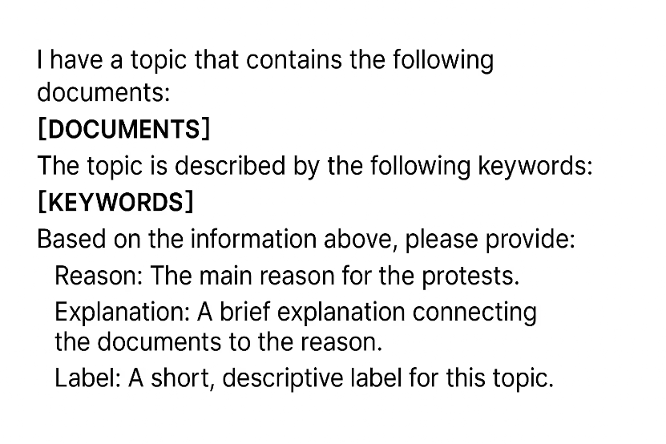
Data Modeling - Mistral
WHY MISTRAL?
While BERTopic may generate closely related clusters , Mistral-7B provides distinct and accurate labels, making each topic more interpretable and actionable.
Used BERTopic to cluster protest documents using transformer-based embeddings and density-based clustering.
Replaced manual topic naming with Mistral-7B LLM, integrated via the BERTopic TextGeneration representation module.
Provided top keywords and representative documents to the LLM using a few-shot prompt containing structured examples with fields: Reason, Explanation, and Label.
Validated LLM-generated labels by reviewing their consistency with actual protest notes and ensured alignment with topic keywords.

Slide 15
Data Modeling - LLaMA
WHY LLaMA?
LLaMA-2 enables context-aware, human-like topic labels by interpreting the semantic relationships between representative documents and keywords within each topic.
It outperforms traditional keyword-only labeling by providing concise, meaningful summaries that reflect the underlying protest motivations.
METHODOLOGY:
Extracted top keywords and representative protest notes for each topic generated via BERTopic.
Constructed a few-shot prompt template using real-world protest examples to guide LLaMA.
Loaded LLaMA-2 7B Chat model through Hugging Face Transformers with a generation pipeline.
Passed topic content and keywords into the prompt to generate:
Reason: Root cause of protest.
Explanation: Contextual narrative describing protest motivations.
Label: A short descriptive title for the topic.

Slide 16
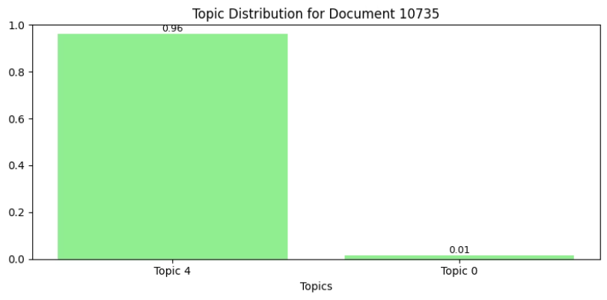
Results - LDA
Topic 0: Labor Protests and Wage Disputes
On 30 January 2022, following a call by the Coordinating Council of Teachers Syndicates in Iran, teachers did a sit-in protest refusing to work at their schools in Qom city (Qom) demanding full implementation of a salary ranking plan and pension payment equalization.
Topic 1: Worker Mobilization in Tehran Districts
Topic 2: Civilian Rallies on International or Humanitarian Issues
Topic 3: Pensioners and Social Security Protests
Topic 4: Education Sector Labor and Salary Movements

Slide 17
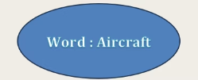
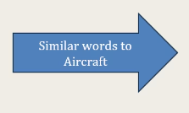
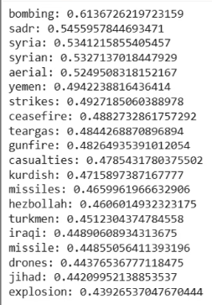
Results-Top2Vec
Model
CV Coherence Score
Topic Diversity Code
Doc2Vec
0.5457
0.3940
Universal Sentence Encoder
0.5030
0.1582

Slide 18
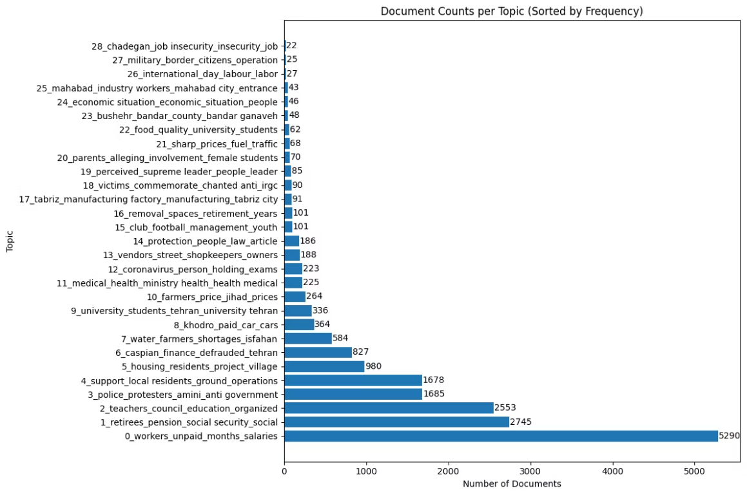
Results - Bertopic
Document Text
Dominant Topic
Probability
Dominant Keywords
Farmers protested at Khowrasgam in central Isfahan Province on the night of April 14 against the shortage of water in the province.
water_farmers_shortages_isfahan
1
water, farmers, isfahan
On 11 May 2023, local residents from Anbar Zaroni village held a protest in front of the governor's office in Kuhdasht (Lorestan) over their village bridge not being rebuilt after a considerable period of time has passed since its destruction.
housing_residents_project_village
0.89
residents, village

Slide 19
Results - Mistral
Document: traders fishers front bushehr provincial governor general office bandar bushehr bushehr customs closure
Reason: Protests related to fishing industry issues in Bushehr province. Explanation: The protests involve various demands related to the fishing industry, including the closure of customs, reduction of power engines in boats, and unpaid wages.
Label: Fishing industry protests in Bushehr
Document: group students najafabad university poor quality campus food
Reason: Poor quality food and accommodation issues at universities.
Explanation: Students from different universities in Iran have been protesting against the poor quality of food and accommodation services provided by their respective campuses.
Label: Student protests over poor quality food and accommodation

Slide 20
Results - LLaMA2
LLaMA-generated labels reflected precise protest motivations based on real descriptions and keyword context.
Interpretable and actionable summaries such as:
“Workers unpaid months wages”
“Retirees pension social security”
“Teachers council education ranking”
3. Manual review confirmed accuracy and relevance of LLaMA-generated labels, offering significant improvement over traditional keyword-only labeling.
4. Indicated strong semantic coherence and high uniqueness across topics.

Slide 21
Comparison of all the models
Model
CV Coherence Score
Topic Diversity Score
LDA
60
84
Top2vec
54
39
Bertopic
72
86
Bertopic + Mistral
72
86
Bertopic + Llama
76
86

Slide 22
Conclusion
This project demonstrates the effective use of Large Language Models (LLMs) and topic modeling techniques to extract structured insights from unstructured conflict data, specifically protest events in Iran from 2016–2025. Traditional models like LDA helped identify overlapping themes, while BERTopic and Top2Vec provided more granular clusters through contextual embeddings. The integration of Mistral-7B and Llama for topic labeling enhanced interpretability, providing human-readable and policy-relevant summaries. My pipeline outperformed LDA in coherence and diversity metrics, and the generated topics revealed nuanced reasons behind civil unrest such as unpaid wages, poor infrastructure, and educational grievances.
Future Scope
Utilize more advanced language models like GPT for higher-quality topic labeling, zero-shot classification, and summary generation.
Limitations
While Mistral-7B and Llama improves label clarity, LLM outputs may still lack full transparency or be sensitive to prompt variations.
Models like BERTopic + Mistral are computationally expensive, requiring significant resources and runtime.

Slide 23
References
https://ieeexplore.ieee.org/document/10041450
https://radimrehurek.com/gensim/auto_examples/index.html
https://dl.acm.org/doi/pdf/10.1145/3677389.3702605

